Slide 1

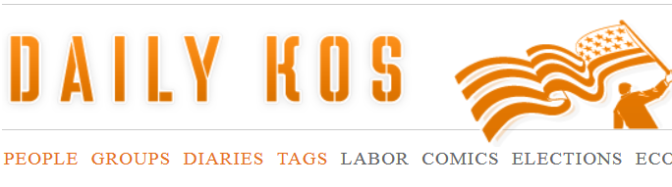
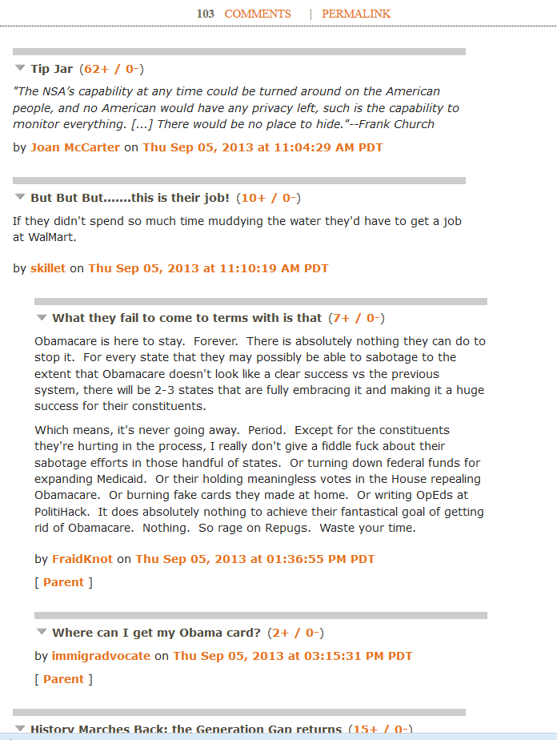

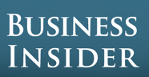


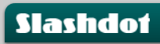
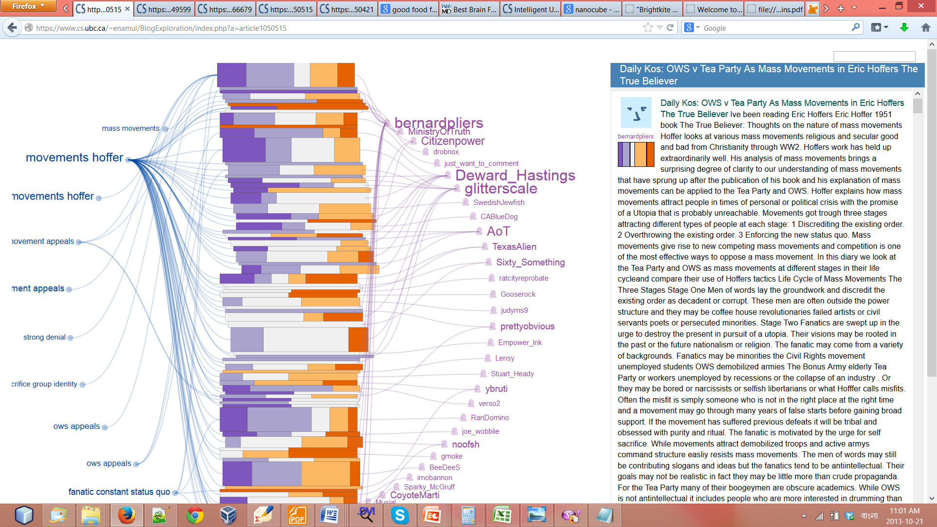
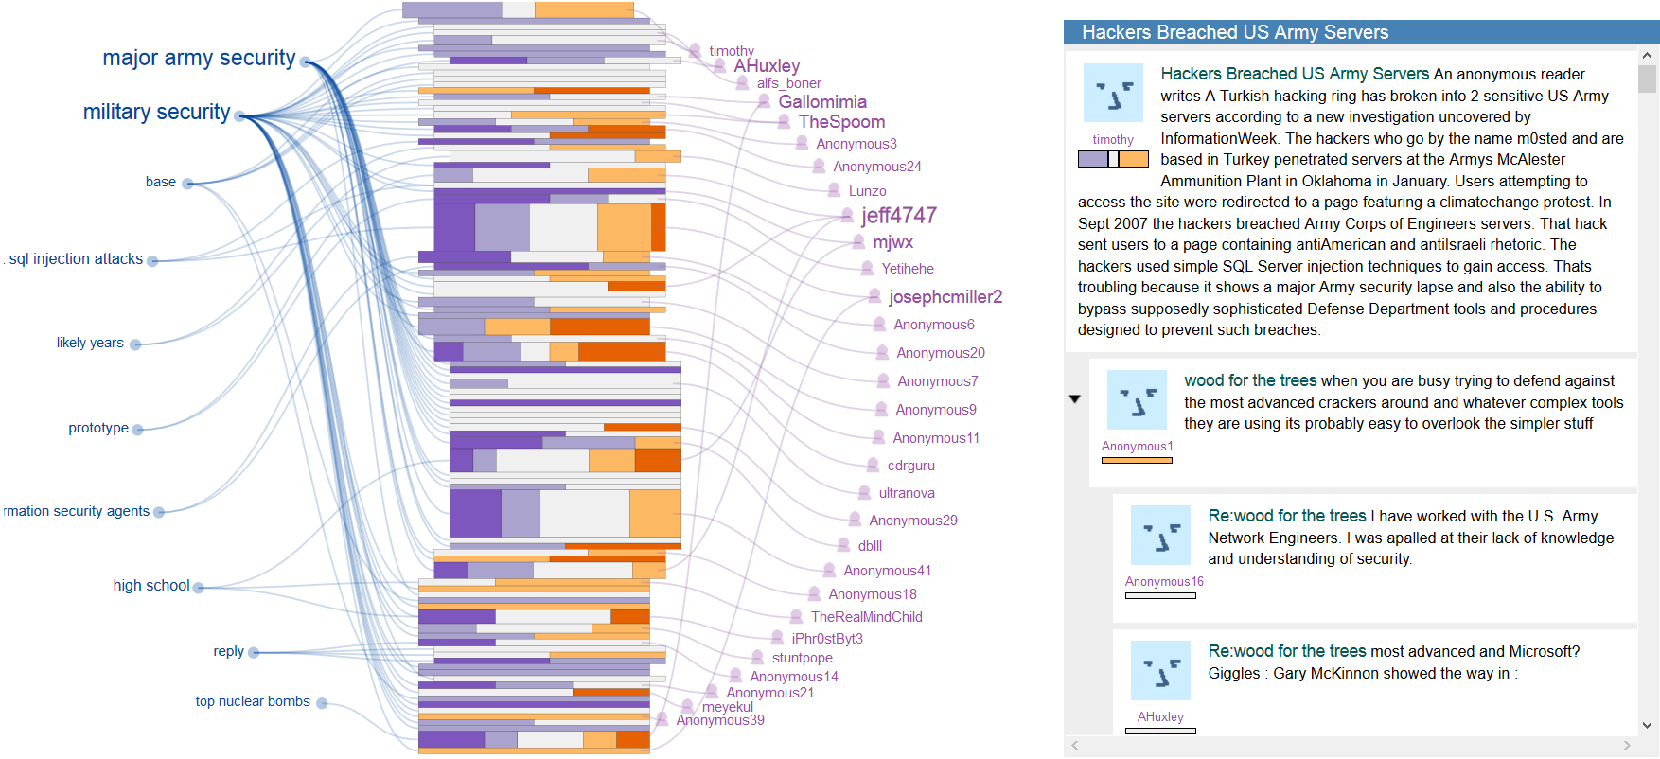
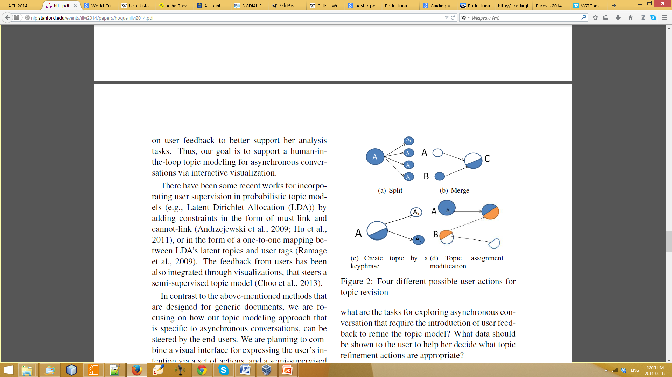
Interactive Exploration of Asynchronous Conversations: Applying a
User-centered Approach to Design a Visual Text Analytic System
Enamul Hoque, Giuseppe Carenini
{enamul,carenini}@cs.ubc.ca
University of British Columbia
Shafiq Joty
sjoty@qf.org.qa
Qatar Computing Research Institute
The Problem
Our Approach
Asynchronous conversations such as a blog can generate a long and complex thread as comments are added by the participants
User centered design
Apply Nested Model [Munzner 2009]
Information overload:
The readers skip comments
Generate short response
Leave the discussion prematurely
What NLP methods should be applied?
What metadata are important?
How the information should be visualized?
Tightly integrate NLP and InfoVis techniques
Applying User Centered Design
Characterizing the
Domain of Blogs
Blog Data and Tasks Abstractions
Extracting Data from Blogs
ConVis: Interactive Visualization of Conversations
Comment
Topic
highly negative
comment length
Why and how people read blogs?
Sample Tasks
highly positive
What this conversation is about?
What do people say about topic X?
Why are people supporting an opinion?
Topic Model
Segmentation: Use graph-based clustering model that considers lexical cohesion and conversational structure.
Labeling: Generate k keyphrases for each segment using graph-based co-ranking method.
Opinion extraction
Apply Semantic Orientation CALculator
Compute polarity distribution for each comment
Variety seeking behaviour
Skimming behaviour
Information and guidance seeking
Keep track of arguments and evidences
Have fun and enjoyment
Thread
Author
Opinion
Topics
Thread Overview
Authors
Conversation view
Interactive Topic model to Support User Tasks
Future Directions
Couple advanced NLP Methods with
Interactive Visualizations
Run a summative evaluation
Why?
Given an initial model:
Topic model might be noisy
Users may be different (e.g., in expertise)
Task may require to change the topic granularity
How?
Underlying Topic Model
updates
User feedback
Topic Split
Topic Merge
Example: A system generated topic is “Military security”.
It consists of sub-topics: “advance hacking”, “defence facility” and “security lapses”.
Task: What opinions are expressed about “security lapses”?
The user needs to split “Military security” into further sub-topics.
Visual Interface
Supports user feedback interactions
Visualizes the changes in the results
For live demo and related papers:
http://www.cs.ubc.ca/~enamul/convis/
Topic Assignment modification

